Slide 1

Amazon Sales Data Analysis
Product, Sales, and Customer Insights
Presented by: Subham Chowdhury
DATE: 16.05.2024

Slide 2
Project Overview
Objective: To gain insights into Amazon's sales data and understand factors affecting sales across different branches.
Branches Analyzed: Mandalay, Yangon, Naypyitaw
Data: 17 columns, 1000 rows including sales transactions, customer details, product lines, and more.

Slide 3
Data Overview
Data Description:
Invoice ID: Unique identifier for sales transactions
Branch: Location of sales
Customer Type: Type of customer (e.g., Member, Normal)
Product Line: Category of product sold
Quantity: Number of units sold
Total: Total sales amount
Date & Time: Timestamp of transaction
Payment Method: Mode of payment (e.g., Cash, Credit Card)
Rating: Rating the product by user.
Data Quality: Ensured no NULL values through database constraints

Slide 4
Feature Engineering
New Columns Added:
timeofday: Categorized as Morning, Afternoon, Evening
dayname: Extracted day of the week
monthname: Extracted month of the year
Purpose: To identify patterns in sales over different times and days

Slide 5
Product Analysis
Objective: To understand performance across different product lines.
Key Findings:
Best Performing Product Line: Electronic accessories
(Sales of 971)
Needs Improvement: Health and Beauty (Sales of 854)
Top Product Line by Revenue: Food and Beverages
($ 56144.844)

Slide 6
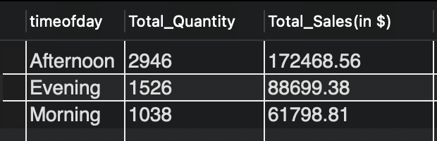
Sales Analysis
Objective: To analyze sales trends and effectiveness of sales strategies.
Key Findings:
Monthly Revenue: January ($ 116291.868)
Sales Peak Time:
Highest Sales Month: January (Sales of 1965)
Cost of Goods Sold Peak: January ($ 110754.16)

Slide 7
Customer Analysis
Objective: To segment customers and analyze their purchasing behaviour.
Key Findings:
Most Frequent Customer Type: Members
Highest Revenue Contributor:: Member ($ 164223.444)
Predominant Gender: Female

Slide 8
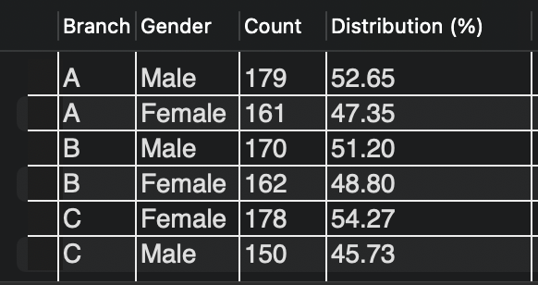
Customer Analysis
Key Findings:
Branch-wise Gender Distribution:

Slide 9
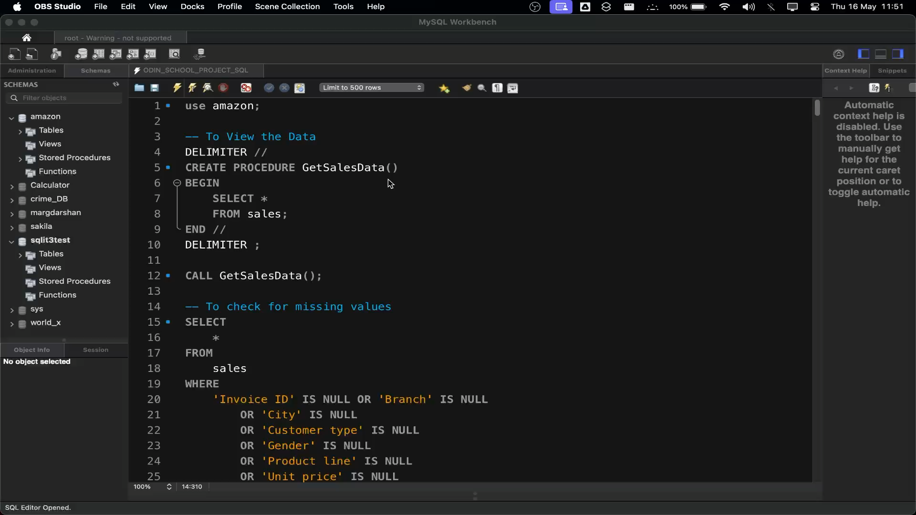
Work Video
Video Content: Overview of the analysis process, key insights, and findings.
Purpose: To provide a visual and engaging summary of the work done.

Slide 10
Business Questions Answered
Distinct Cities: 3 (Mandalay, Yangon, Naypyitaw)
Product Lines: 6 (Health and Beauty, Electronic accessories, Home and Lifestyle, Sports and travel, Food and Beverages, Fashion accessories)
Frequent Payment Method: Ewallet
City with Highest Revenue: Naypyitaw
Product Line with Highest VAT: Fashion accessories (4.965%)
Customer Type with Highest VAT Payments: Member (4.965%)
Day with Highest Ratings: Monday (Average Rating of 7.2)

Slide 11
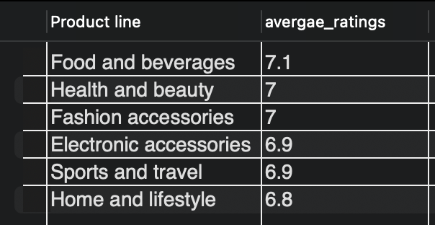
Business Questions Answered
Average Rating per Product Line:

Slide 12
Recommendations
Product Strategy:
Focus on improving Health and Beauty Product Line.
Promote high-revenue generating products
Sales Strategy:
Increase marketing during Afternoon.
Introduce offers in February.
Customer Engagement:
Target Members with loyalty programs.
Personalized campaigns for predominant gender in each branch.

Slide 13
Conclusion and Next Steps
Summary:
Detailed insights into product performance, sales trends, and customer segments
Data-driven recommendations for boosting sales and customer engagement
Next Steps:
Implement recommended strategies
Continuous monitoring and analysis for improvement
Further analysis on customer feedback and satisfaction

Slide 14



